Slide 1


Introduction - Libraries Imported
MADHAV INSTITUTE OF TECHNOLOGY & SCIENCE, GWALIOR (M.P.)
A Govt. Aided UGC Autonomous & NAAC Accredited Institute, Affiliated to R.G.P.V, Bhopal
Machine Learning and Optimization (280404)
Breast Cancer Analysis and Prediction using KNN Model Building
Group Members :
Anant Sharma (0901AM211011)
Anshika Tripathi (0901AM211012)
Anushka Khemaria (0901AM211013)
Arnav Khamparia (0901AM211014)
Aryan Singh (0901AM211015)
Submitted by :
Aryan Singh
(0901AM211015)
Submitted to :
Dr. Vibha Tiwari

Slide 2
Introduction - Libraries Imported
Numpy - NumPy is a Python library for numerical computation that provides efficient arrays and mathematical functions for working with them.
Pandas - Pandas is a Python library for data manipulation and analysis that provides powerful data structures and tools for handling data.
Matplotlib - Matplotlib is a Python library for creating static, animated, and interactive visualizations in various formats such as line plots, bar charts, histograms, scatter plots, and more.
Seaborn - Seaborn is a Python data visualization library built on top of Matplotlib that provides a high-level interface for creating statistical graphics such as heatmaps, distribution plots, time series, and more.
Scikit-learn - Scikit-learn (sklearn) is a popular machine learning library for Python that provides tools for classification, regression, clustering, dimensionality reduction, model selection, and preprocessing of data.

Slide 3
Breast Cancer Prediction Model
Breast cancer is a major health issue that affects millions of people worldwide. It is the most common cancer among women.
Diagnosis of this cancer requires a highly trained medical professional to interpret medical imaging results and conduct invasive procedures.
To assist this problem we have prepared a machine learning model using K-Nearest Neighbors (KNN) algorithm, which is non parametric classification algorithm used in machine learning.

Slide 4
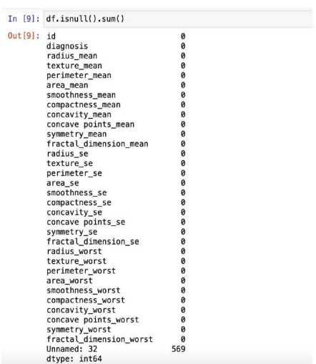
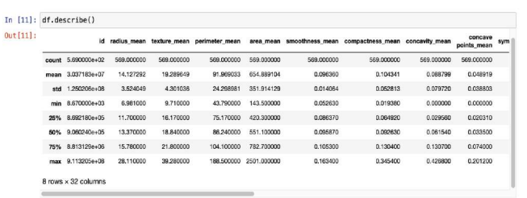
K-Nearest Neighbours (KNN)
Principle: KNN is a non-parametric algorithm that makes predictions based on the k closest examples in the training set to the input.
Distance Metric: The algorithm uses a distance metric, often Euclidean distance, to measure the similarity between two examples in the input space.
Hyperparameters: The key hyperparameters of the KNN algorithm are the value of k and the distance metric, both of which can have a significant impact on performance.
Strengths: KNN is simple, intuitive, and can work well when the decision boundary is nonlinear or the data is noisy.
Weaknesses: KNN can be slow at test time, requires storage of the training set, and can perform poorly when the number of features is high or irrelevant features are present.

Slide 5
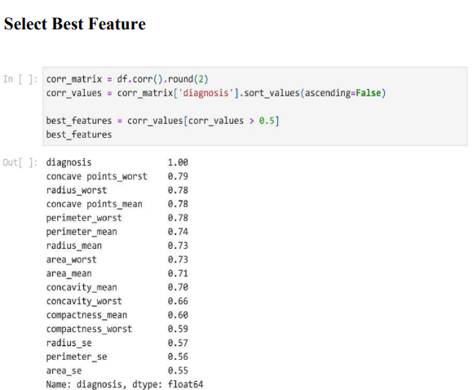
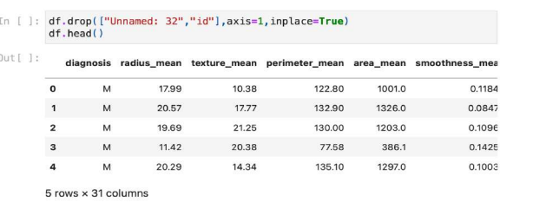
Data Preprocessing
The dataset is large and It may contain some error.
In order to eliminate those error, data Pre-processing is used, We have used Null function to display data statistics and Describe function to check if there is any null value in dataset

Slide 6
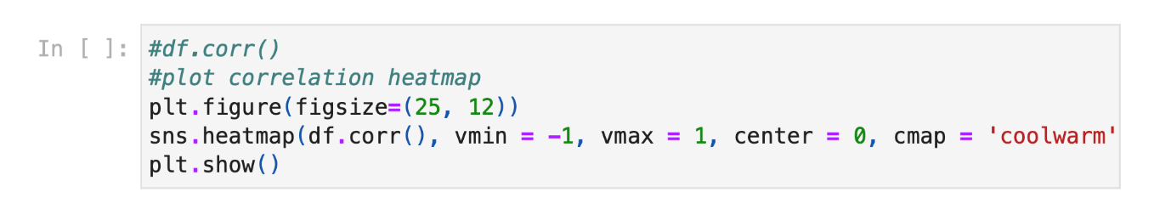
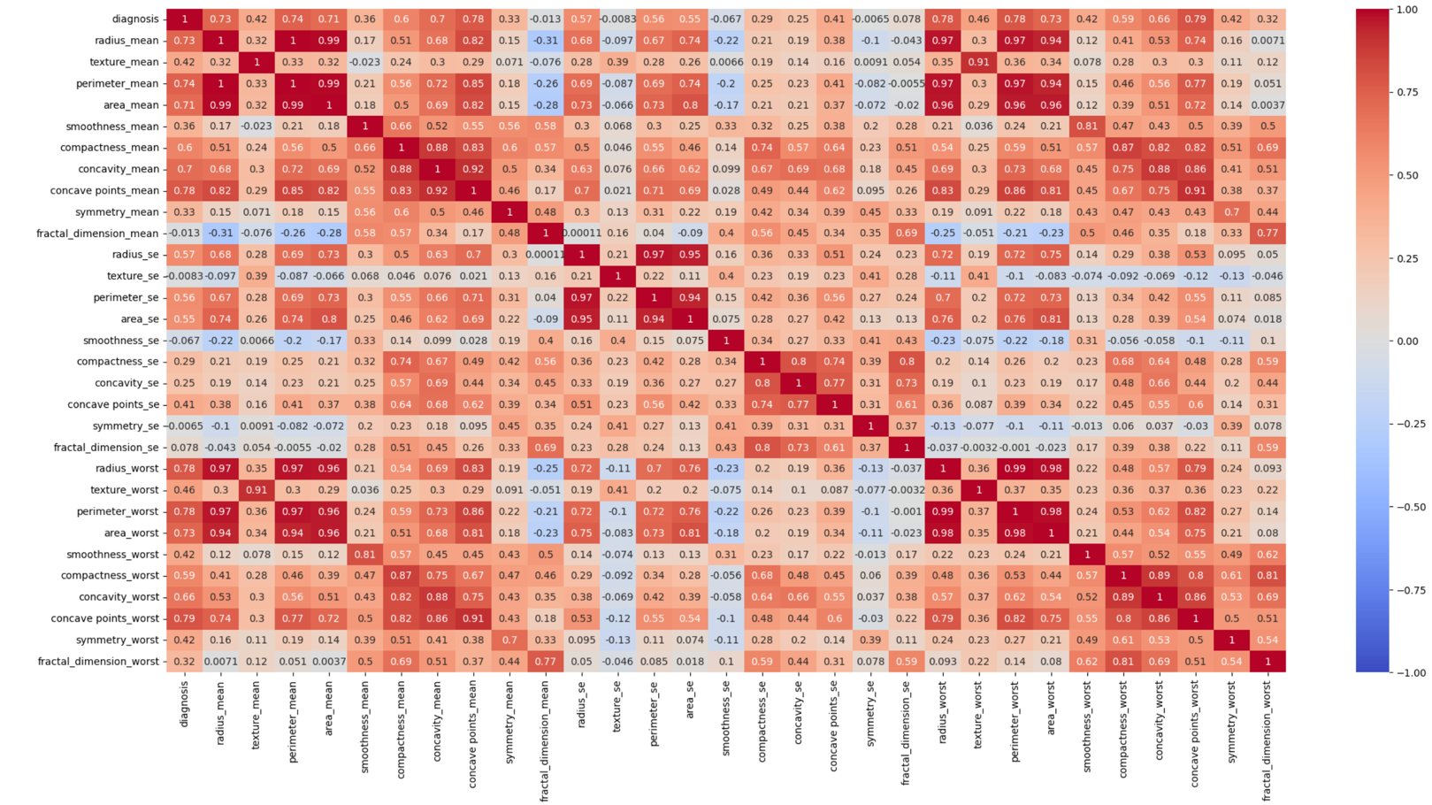
Exploratory Data Analysis
Exploratory Data Analysis (EDA) is used to investigate and analyze the data in their main characters.
It consist of dropping the irrelevant data which will not be used in prediction.
We have used drop function to eliminate selected column and selected best feature

Slide 7
Data input-logic-output relationship
Correlation heatmap is plotted to gain understanding of relationship between target features & independent features.
We can see that lot of features are highly correlated with target variable.
To gain insights about relationship between input & output different types of visualization are plotted which we will see in EDA section of this report.

Slide 8
Training & Testing Data
The 80 precent of the total data is used to train the model and 20 percent of the data for testing the model.
Each instance in the dataset corresponds to a tumor found in a patient, and is described by a set of features.
The first column in the dataset is an ID number for the patient.
The second column is the diagnosis of the tumor, where 'M' indicates a malignant tumor and 'B' indicates a benign tumor

Slide 9
Conclusion
Key Findings | Value | Interpretation
Best Features | diagnosis, concave points_worst, radius_worst, concave points_mean, perimeter_worst, perimeter_mean, radius_mean, area_worst, area_mean, concavity_mean, concavity_worst, compactness_mean, compactness_worst, radius_se, perimeter_se, area_se | The most useful and relevant input variables that improve the performance of a machine learning model in predicting outcomes.
Cross Validation | [0.87719298 0.92105263 0.94736842 0.93859649 0.91150442] | Evaluating ML model through iterative training/testing on data subsets.
Average Cross Validation | 0.9191429902189101 | Estimating model performance using mean of cross-validation scores.
Confusion Matrix | [[71 1] [ 8 34]] | A table summarizing performance of a classification model by comparing predicted and actual class labels.
Accuracy Score | 0.9210526315789473 | A metric that measures the percentage of correct predictions made by a classification model.

Slide 10

THANK YOU

